Slide 1

Web development
Web development is the work involved in developing a website for the Internet or an intranet.

Slide 2

As an industry
Web development has transformed communication and commerce.

Slide 3

Chronology

Slide 4
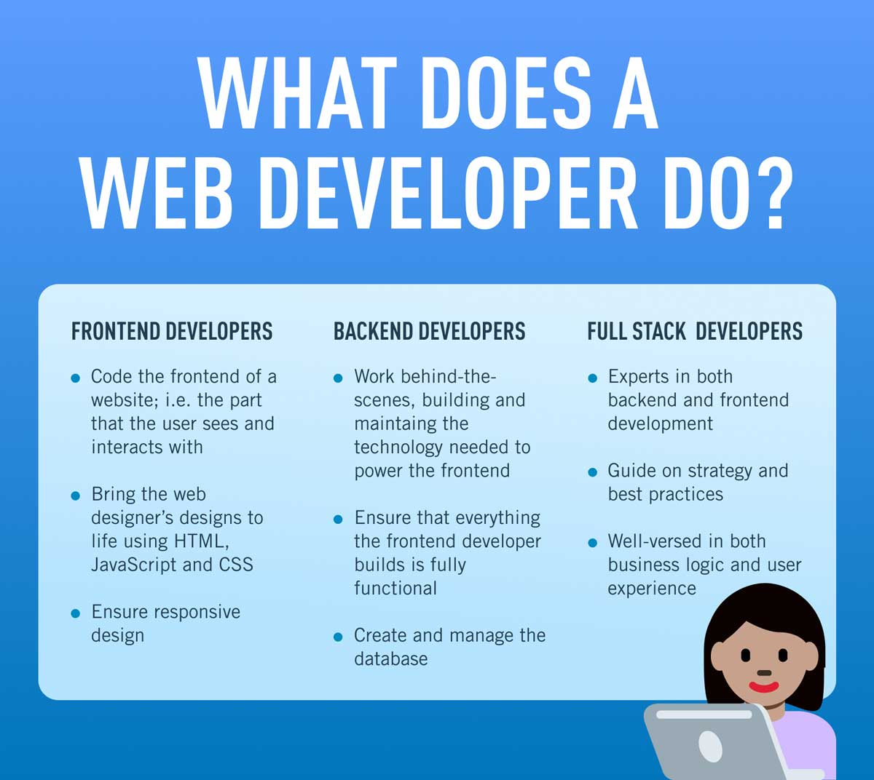
Practical Web development
lopment
Web analytics
Social media management
Search engine optimization
Search engine marketing
Web security
Web hosting
Web server administration
We

Slide 5

Security considerations
Web development takes into account many security considerations.

